Slide 1



Slide 2



01CE0410 – Computer Network
Unit - 2
Application Layer
Prof. Megha Mudholkar
Computer Engineering Department

Slide 3


Outline
World Wide Web
HTTP
File Transfer: FTP
Electronic mail in the internet – SMTP, POP 3 & IMAP
Domain name server
SNMP
DHCP: Request and Response

Slide 4

World Wide Web

Slide 5
World Wide Web
What is WWW?
World wide web is collection of millions of files stored on thousand of servers all over the world.
These files represents documents, pictures, video, sounds, programs, interactive environments.
What is Webpage?
A webpage is an HTML document that is stored on a web server.
What is Website?
A website is a collection of web pages belonging to a particular organization.
URL of these pages share a common prefix, which is the address of the home page.

Slide 6
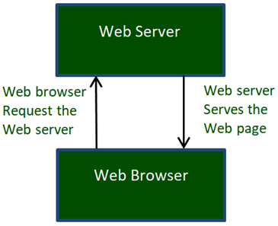
World Wide Web
How the world wide web works?
The servers store and transfer web pages or information to user's computers on the network when requested by the users.
A web server is a software program which serves the web pages requested by web users using a browser.
The user computer who requests documents from a server is known as a client.
Browser, which is installed on the user' computer, allows users to view the retrieved documents.
All the websites are stored in web servers. A website occupies a space in a server and remains stored in it.

Slide 7
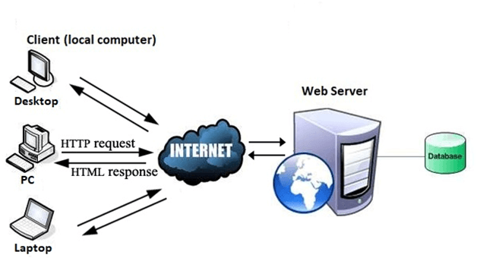
World Wide Web
How the world wide web works?
The server hosts the website whenever a user requests its Webpages, and the website owner has to pay the hosting price for the same.
The moment you open the browser and type a URL in the address bar or search something on Google, the WWW starts working.
There are three main technologies involved in transferring information: Hypertext Markup Language (HTML), Hypertext Transfer Protocol (HTTP) and Web browsers.

Slide 8
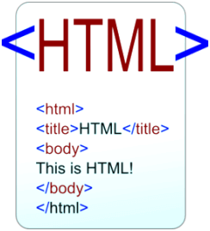
World Wide Web
HTML
HTML is a standard markup language which is used for creating web pages.
It describes the structure of web pages through HTML elements or tags.
These tags are used to organize the pieces of content such as 'heading,' 'paragraph,' 'table,' 'Image,' and more.
You don't see HTML tags when you open a webpage as browsers don't display the tags and use them only to render the content of a web page.
In simple words, HTML is used to display text, images, and other resources through a Web browser.

Slide 9

World Wide Web
Web Browsers
A web browser, which is commonly known as a browser, is a program that displays text, data, pictures, videos, animation, and more.
It provides a software interface that allows you to click hyperlinked resources on the World Wide Web.
When you double click the Browser icon installed on your computer to launch it, you get connected to the World Wide Web and can search Google or type a URL into the address bar.
Today, they are more advanced; along with browsing you can use them for e-mailing, transferring multimedia files, using social media sites, and participating in online discussion groups and more.
Examples:

Slide 10
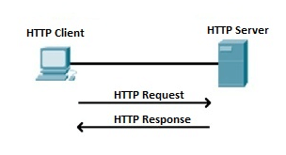
World Wide Web
HTTP
This protocol defines how messages are formatted and transmitted and what actions the Web Server and browser should take in response to different commands.
When you enter a URL in the browser, an HTTP command is sent to the Web server, and it transmits the requested Web Page.
When we open a website using a browser, a connection to the web server is opened, and the browser communicates with the server through HTTP and sends a request.
HTTP is carried over TCP/IP to communicate with the server. The server processes the browser's request and sends a response, and then the connection is closed.
Thus, the browser retrieves content from the server for the user.

Slide 11
HTTP

Slide 12
HTTP
HTTP stands for hyper text transfer protocol.
It is a standard web transfer protocol.
HTTP transfer multimedia documents through HTML.
HTTP works with request response behavior.
HTTP supports two types of request: Simple Request and Full Request.

Slide 13
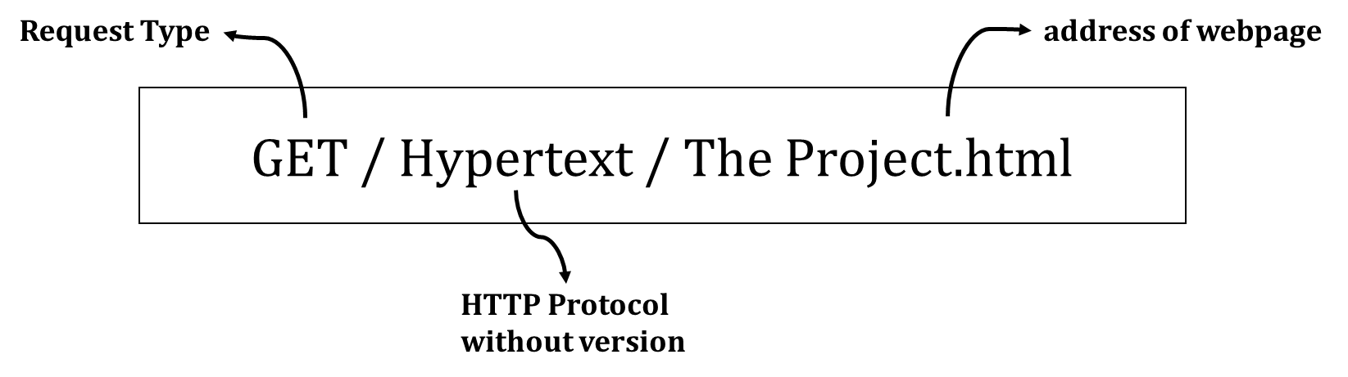
HTTP
Simple Request
A simple request is just a single GET line naming the page desired, without the protocol version.
The response is just the raw page with no headers, no MIME, and no encoding.

Slide 14
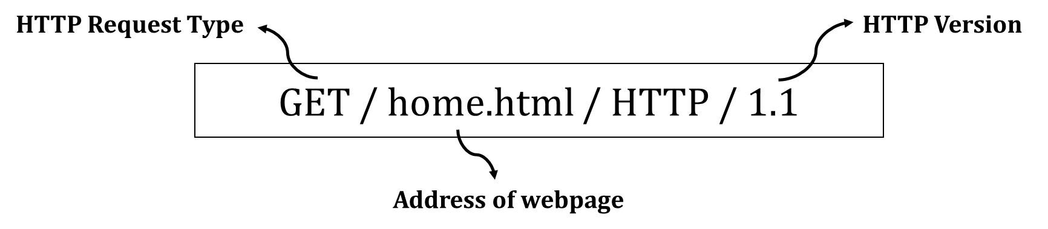
HTTP
Full Request
Full request are indicated by the presence of the protocol version on the GET request line.
The first word on the full request line is simply the name of the method to be executed on the web page.
Full request contains the command, the page desired, and the protocol/version.
The names are case sensitive, so, GET is a valid method but get is invalid.

Slide 15
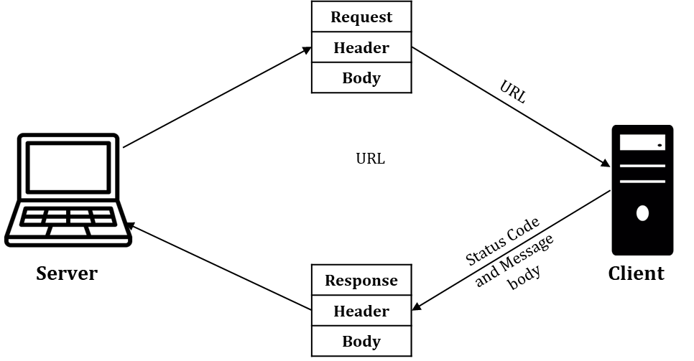
Working of HTTP
HTTP uses the services of TCP. HTTP is a stateless protocol.
The client initialize the transaction by sending a request message. The server replies by sending a response.
Client
Server

Slide 16
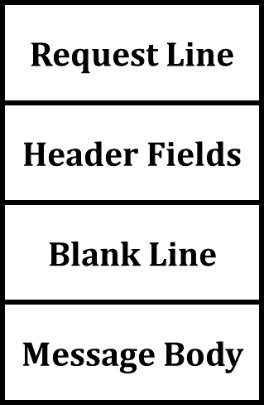
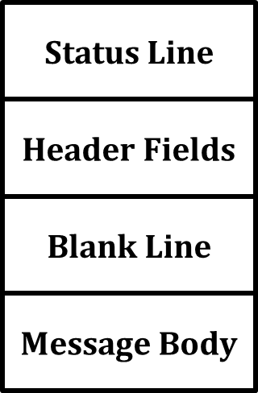
Working of HTTP
HTTP messages are two types: 1. Request 2. Response.
Both message used same format. Request message consist of a request line, headers and a body. Figure shows request message.
Fig. Format of request message
Fig. Format of response message

Slide 17
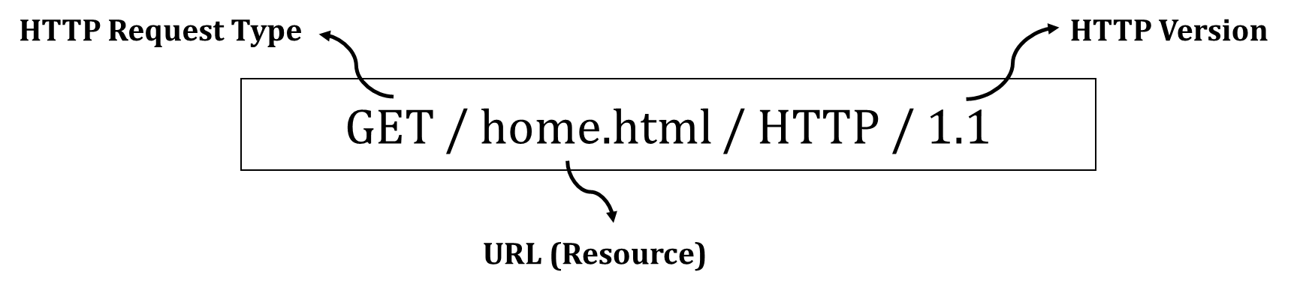
Working of HTTP
Request Message
Request line defines 3 elements: Request type, URL, http version
Request Type: It categorizes the request message into several methods for HTTP version 1.1.
i.e., GET, POST, DELETE, PUT, COPY, MOVE, LINK, UNLINK
URL: URL is path of webpage.
HTTP Version: Here http version is 1.1
Fig. Format of request message

Slide 18
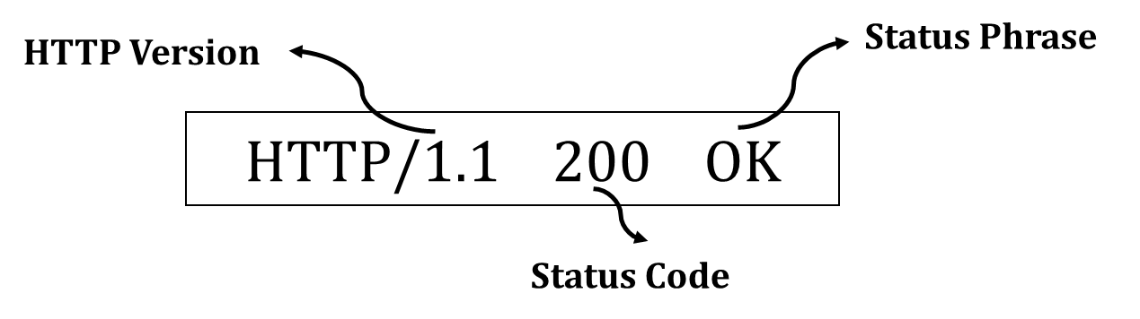
Working of HTTP
Response Message
Once the server receives an HTTP request from the client, it returns an HTTP response.
Status Line: HTTP/1.1 200 OK
Status Code:
200 OK : Request succeeded.
301 Moved Permanently : Requested object moved
400 Bad Request : Request message not understood by server
404 Not Found : Requested document not found on this server
505 HTTP Version Not Supported : Requested http version not support
Fig. Format of response message

Slide 19
HTTP Header
Request Line
Status Line
Status Line
HTTP/1.1 200 OK
Header Fields
Header Fields
General Header
Date : Wed, 11 Aug 2021 13:00:13 GMT
Blank Line
Blank Line
Connection : Close
Message Body
Message Body
Response Header
Server : Apache / 1.3.27
Format of Request Message
Format of Response Message
Accept-Ranges : bytes
Entity Header
Content-Type : text/html
A four different header are used:
general header
response header (in response message)
entity header
request header (in request message)
Header can be one or more header lines.
Content-Length : 200
Last-Modified : 1 Aug 2021 13:00:13 GMT
Blank Line
Message Body
<html>
<head>
<title> Welcome to the India <title>
</head>
<body>

Slide 20
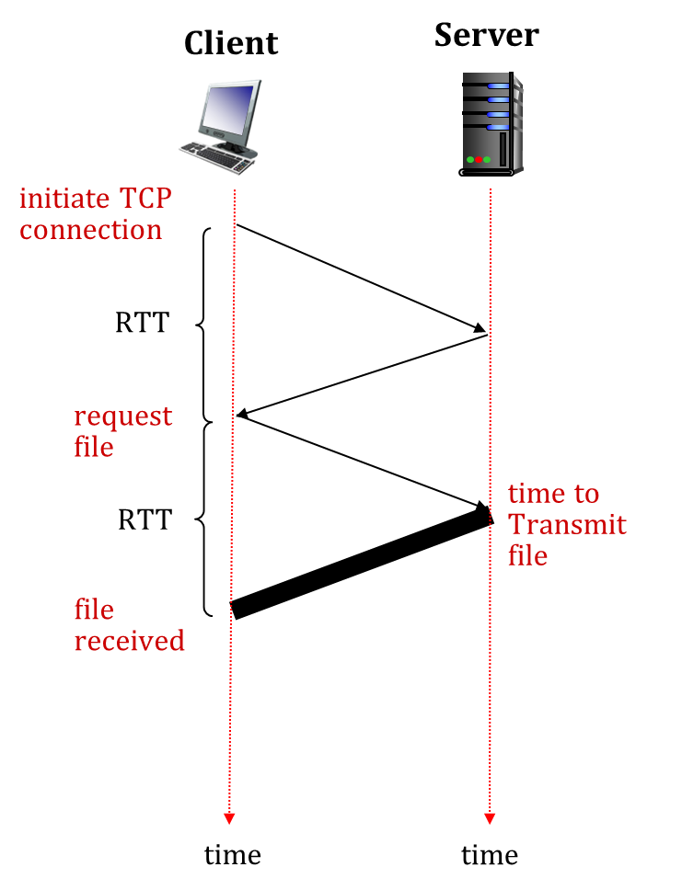
HTTP Connection
There are two types of HTTP Connection:
Non-Persistent HTTP
Persistent HTTP
RTT(round-trip time): A time for a small packet to travel from client to server and server to client.
HTTP response time:
1-RTT to initiate TCP connection.
1-RTT for HTTP request & response.
File transmission time
HTTP Response Time = No. of RTT + file transmit time

Slide 21
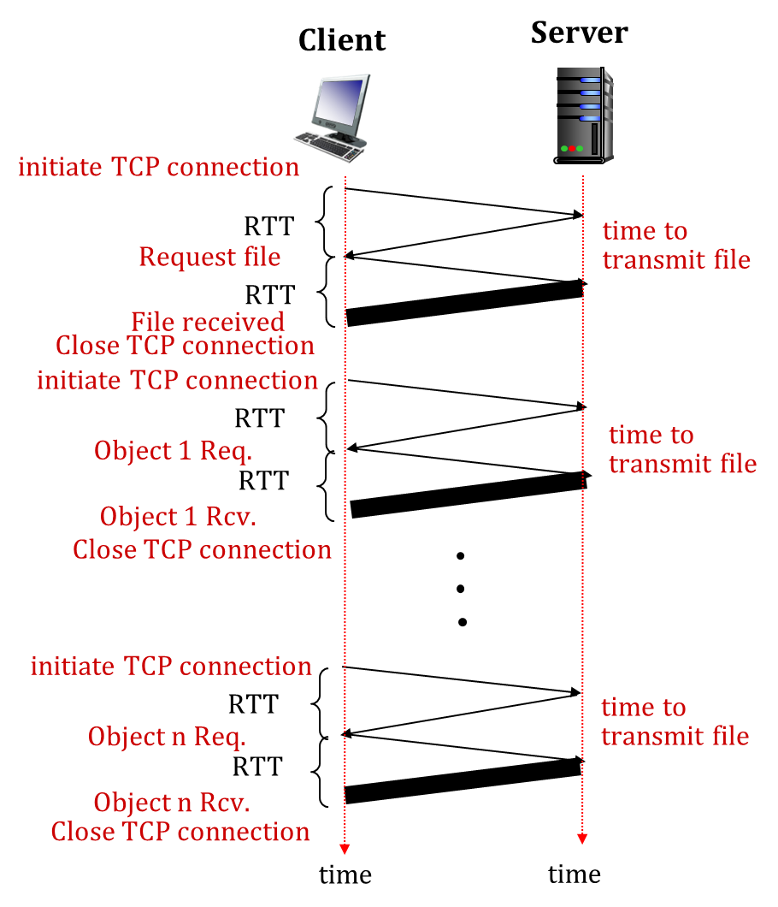
HTTP Connection
Non-Persistent HTTP
Non-persistent connections are the default mode for HTTP/1.0.
A non-persistent connection is closed after the server sends the requested object to the client.
The connection is used exactly for one request and one response.
For downloading multiple objects it required multiple connections.
Example:
Transferring a webpage from server to client, webpage consists of a base HTML file and 10 JPEG images.
Total 11 object are reside on server.
Non-Persistent HTTP = 2 RTT + 1 file transmit time
11 object = 22 RTT + 11 file transmit time

Slide 22
HTTP Connection
Persistent HTTP
HTTP 1.1 made persistent connections the default mode.
The server now keeps the TCP connection open for a certain period of time after sending a response.
This enables the client to make multiple requests over the same TCP.
Types of persistent connection:
Without pipelining
With pipelining

Slide 23
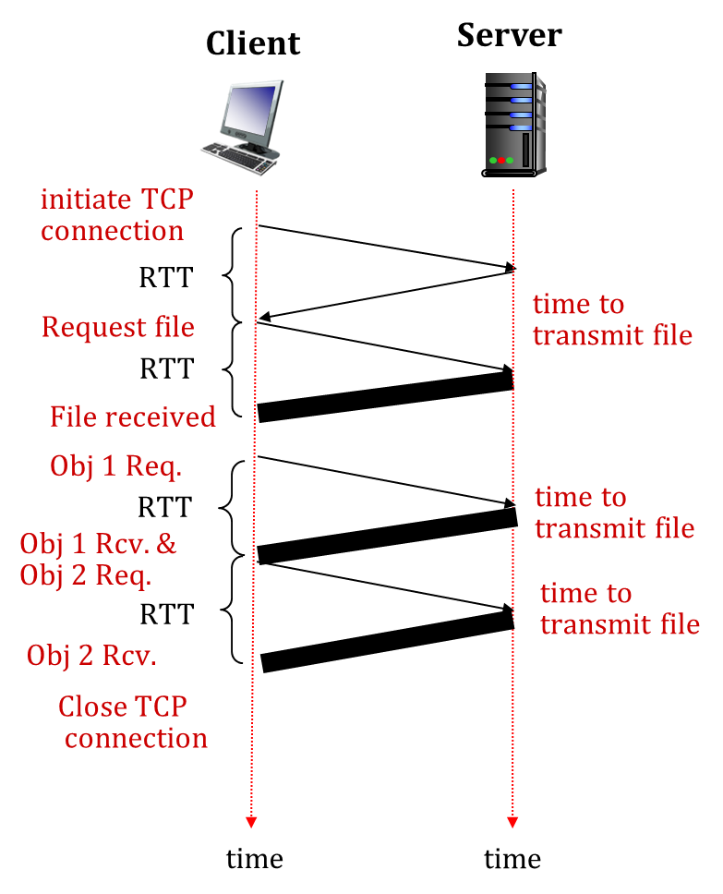
HTTP Connection
Persistent HTTP (Without Pipelining)
The client issues a new request only when the previous response has been received.
The client experiences one RTT in order to request and receive each of the referenced objects.
TCP connection is idle. i.e., does nothing while it waits for another request to arrive.
This idle situation wastes server resources.

Slide 24
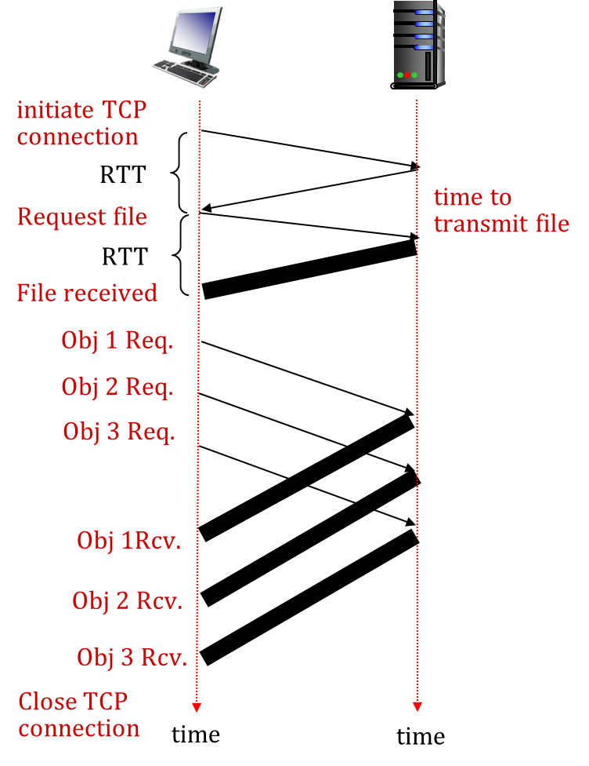
HTTP Connection
Persistent HTTP (With Pipelining)
Default mode of HTTP 1.1 uses persistent connections with pipelining.
Client issues a request as soon as it encounters a references.
The HTTP client can make back to back requests for the referenced objects.
It can make a new request before the back-to-back requests, it sends the objects back-to-back.
Pipelined TCP connection remains idle for a smaller fraction of time.

Slide 25
Persistent HTTP vs Non-persistent HTTP
Exercise

Slide 26
File Transfer Protocol (FTP)

Slide 27
FTP
FTP stands for File transfer protocol.
FTP is a standard internet protocol provided by TCP/IP used for transmitting the files from one host to another.
It is mainly used for transferring the web page files from their creator to the computer that acts as a server for other computers on the internet.
It is also used for downloading the files to computer from other servers.

Slide 28
FTP
Objectives of FTP
It provides the sharing of files.
It is used to encourage the use of remote computers.
It transfers the data more reliably and efficiently.
Need of FTP
Transferring files from one system to another is very simple and straightforward, but sometimes it can cause problems.
For example, two systems may have different file conventions. Two systems may have different ways to represent text and data.
Two systems may have different directory structures. FTP protocol overcomes these problems by establishing two connections between hosts.
One connection is used for data transfer, and another connection is used for the control connection.

Slide 29
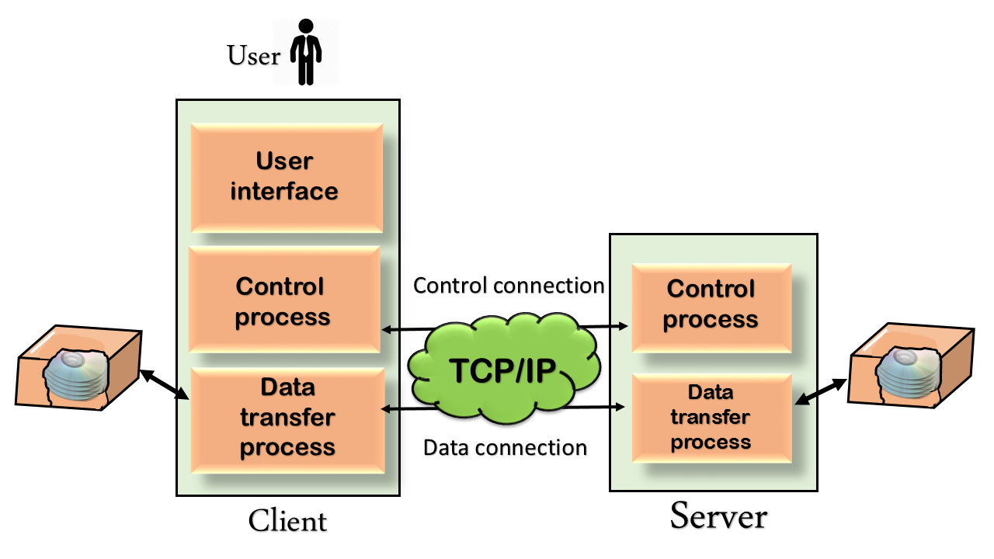
FTP
Working of FTP
Figure shows the basic model of the FTP.
The FTP client has three components: the user interface, control process, and data transfer process.
The server has two components: the server control process and the server data transfer process.

Slide 30
FTP
Working of FTP
There are two types of connections in FTP: Data Connection and Control Connection.
Control Connection: The control connection uses very simple rules for communication. Through control connection, we can transfer a line of command or line of response at a time. The control connection is made between the control processes. The control connection remains connected during the entire interactive FTP session.
Data Connection: The Data Connection uses very complex rules as data types may vary. The data connection is made between data transfer processes. The data connection opens when a command comes for transferring the files and closes when the file is transferred.

Slide 31
FTP
Working of FTP
FTP Clients
FTP client is a program that implements a file transfer protocol which allows you to transfer files between two hosts on the internet.
It allows a user to connect to a remote host and upload or download the files.
It has a set of commands that we can use to connect to a host, transfer the files between you and your host and close the connection.
The FTP program is also available as a built-in component in a Web browser.
This GUI based FTP client makes the file transfer very easy and also does not require to remember the FTP commands.

Slide 32
FTP
Characteristics of FTP
Speed: The FTP is one of the fastest way to transfer the files from one computer to another computer.
Security: To access the FTP server, we need to login with the username and password. Therefore, we can say that FTP is more secure.
Back & forth movement: FTP allows us to transfer the files back and forth. Suppose you are a manager of the company, you send some information to all the employees, and they all send information back on the same server.

Slide 33
Email

Slide 34
Email
Email stands for Electronic Mail.
Email service allows an Internet user to send a message in formatted manner (mail) to the other Internet user in any part of world.
Message in mail not only contain text, but it also contains images, audio and videos.
The person who is sending mail is called sender and person who receives mail is called recipient.
Simple mail transfer protocol (SMTP) is the standard mechanisms for electronic mail in the internet. Mail server handles incoming and outgoing mails.
The post office protocol (POP) store incoming mail while SMTP handle outgoing mails.

Slide 35
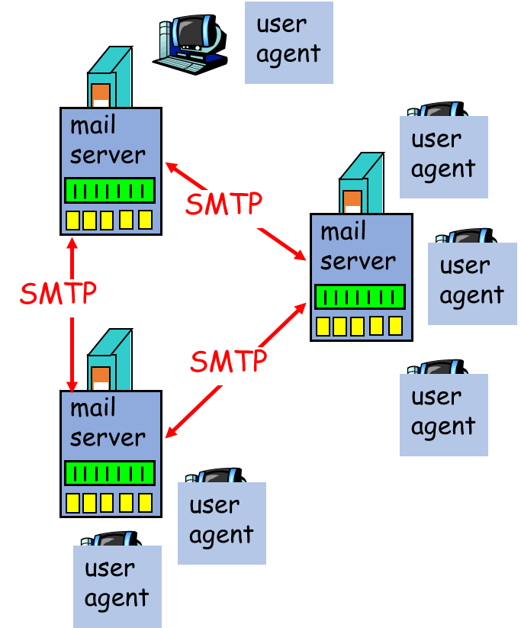
Email
High level view of Internet mail system and its key components: User agents, Mail servers, SMTP (Simple Mail Transfer Protocol)
User Agent
User agents allow users to read, reply to, forward, save, and compose messages.
E.g. Microsoft Outlook and Apple Mail.
Mail servers:
A mailbox contains incoming messages for user.
A message queue of outgoing (to be sent) mail messages.
SMTP
It is a principal application layer protocol between mail servers to send email messages.
client: sending mail to server
server: receiving mail from other different mail server

Slide 36
Email
Feature of Email
E-mail system support five features:
Composition
Transfer
Reporting
Displaying
Disposition
Composition: It is process of creating or replying the message.
Transfer: It is moving from the originator to the receiver .
Reporting: It inform the originator what happened to the message.
Displaying: Display E-mail on user screen.
Disposition: It means read, save, reply, forward, delete the message. It is depends on receiver.

Slide 37
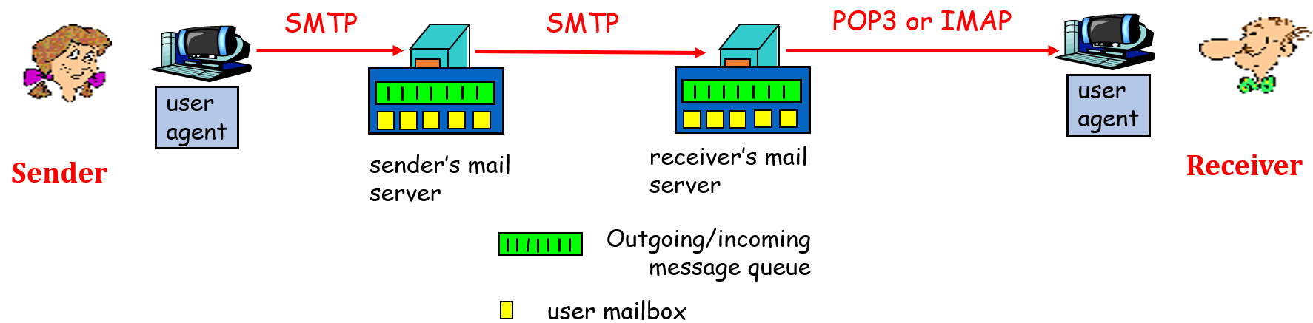
Email
Email Protocol
There are main 3 protocols in email system:
SMTP
POP 3
IMAP
SMTP: delivery/storage to receiver’s server.
POP & IMAP : Mail Access from server and display mail.

Slide 38
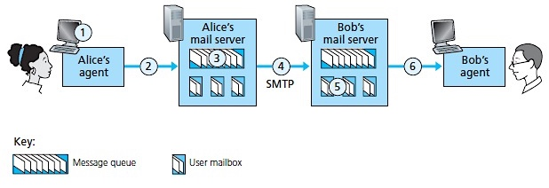
Email
SMTP
Alice uses user agent to compose message to bob@gmail.com (uses SMTP)
Alice’s user agent sends message to her mail server; message placed in message queue. (uses SMTP)
Client side of SMTP opens TCP connection with Bob’s mail server. (uses SMTP)
SMTP client sends Alice’s message over the TCP connection. (uses SMTP)
Bob’s mail server places the message in Bob’s mailbox. (uses SMTP)
Bob invokes his user agent to read message. (Not used SMTP)

Slide 39
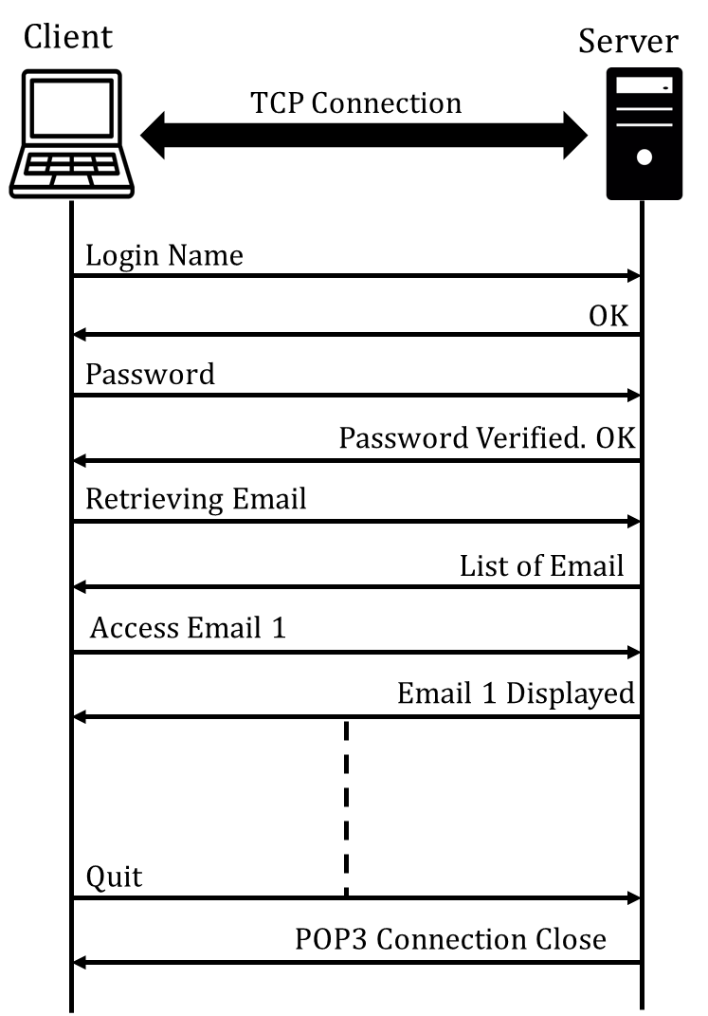
Email
POP3
Post office protocol 3 (POP 3) is Mail access Protocol.
It is used to transfer e-mail from a mail server to client software.
POP 3 uses port no 110 using TCP connection.
After TCP connection established, POP3 performs 3 phases: Authorization, Transaction, Update.
In authorization phase, user agent sends a user name and a password to authenticate the user downloading the mail.
In transaction phase, the user agent retrieves message, mark massages for deletion & remove deletion mark.
In update phase, after the quit command by client, ending the POP3 session; the mail server deletes marked messages.

Slide 40
Email
POP3 Functionality
POP3 is designed to delete mail on the server as soon as the user has downloaded it.
POP3 has two modes: Delete mode and Keep mode.
In the delete mode, mail is deleted from the mailbox after each retrieval.
In the keep mode, the mail remains in the mail box after download.

Slide 41
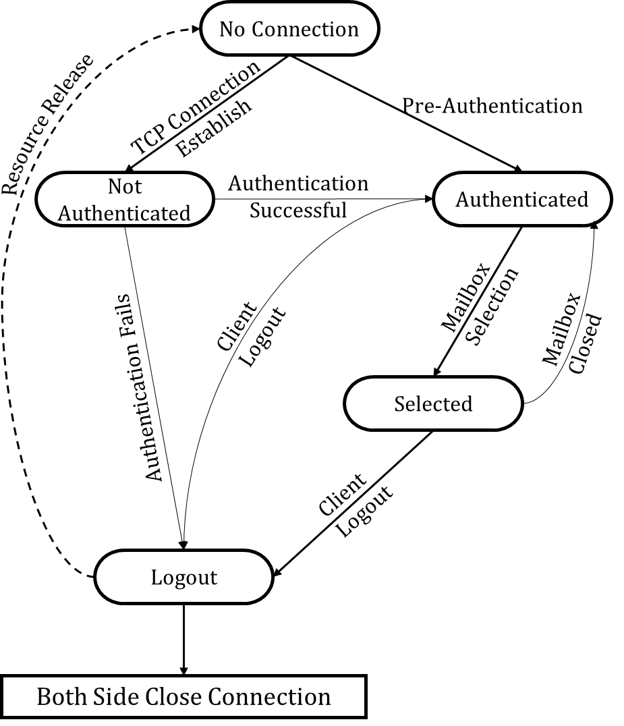
Email
IMAP
IMAP state transition diagram:
Not authenticated: Client provides authentication information to the server.
Authenticated: Server verify the information and client is now allowed to perform on a mailbox.
Selected: Client is allowed to access manipulated individual messages within the mailbox.
Logout: Client send logout command for closing IMAP session.

Slide 42
Email
IMAP Functionality
To keeps all messages in one place: at server
The recipient can then move and organize the message into a new, user-created folder, read the message, delete the message, move messages from one folder to another and so on.
To allow users to search remote folders for messages matching specific criteria.
Also permit a user agent to obtain components of messages, When low-bandwidth connection between the user agent and its mail server. In this case, user not to download all the messages in its mailbox, particularly avoiding long messages like an audio or video clip.

Slide 43
DNS

Slide 44
DNS
DNS stands for Domain Name System.
Human Brain cannot remember more numbers in compare to name.
DNS is required for the functioning of the internet.
DNS is a directory service that provides a mapping between the name of a host on the network and its numerical address.
DNS is a service that translates the domain name into IP addresses. This allows the users of networks to utilize user-friendly names when looking for other hosts instead of remembering the IP addresses.
For example, suppose the “facebook.com” has an IP address of 132.147.165.50, most people would reach this site by specifying “facebook.com”. Therefore, the domain name is more reliable than IP address.
Notes:
https://www.youtube.com/watch?v=72snZctFFtA

Slide 45
DNS
DNS includes following Components:
Components of DNS
Domain name
Name Space
Name server
Name resolver

Slide 46
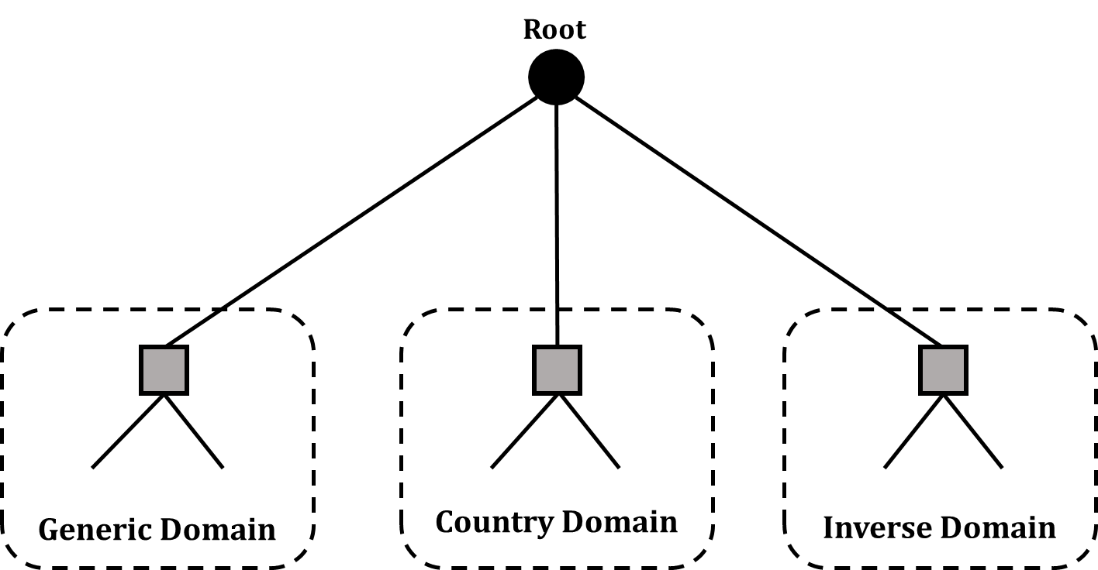
DNS
Domain Name
Domain name is divided into main three different categories in the internet.
i.e., Generic domain, Country domain and Inverse domain.
Each node in tree defines a domain, which is an index to the domain name space database.

Slide 47
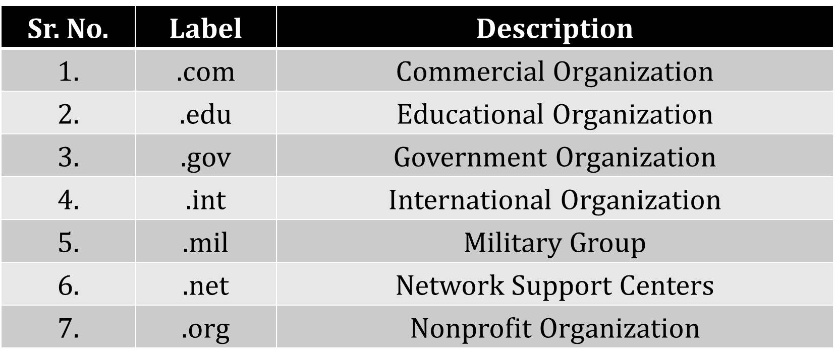
DNS
Generic Domain
The 3 character domains are called the generic domains.
Generic domain labels are as follows

Slide 48
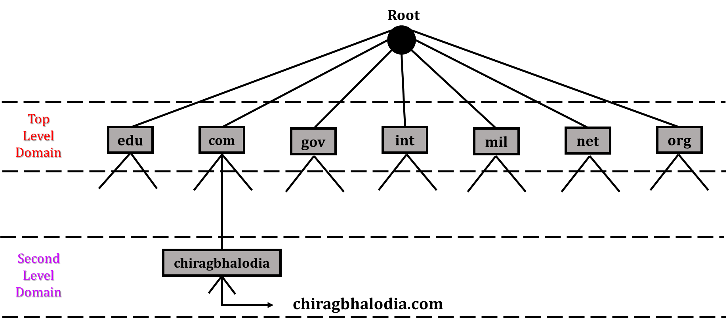
DNS
Generic Domain
For Example, abc.com
abc
Abc.com

Slide 49
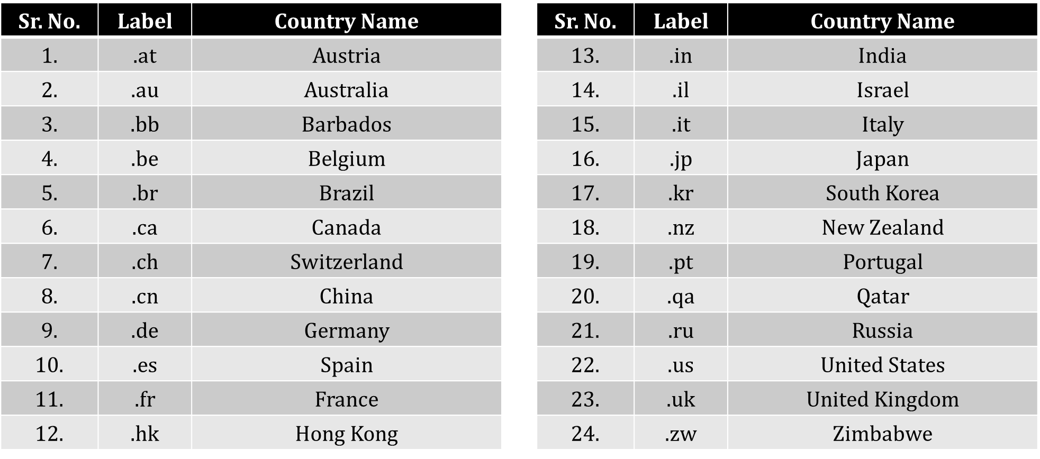
DNS
Country Domain
The 2 character domains are called the country domains.
Country domain uses two character country abbreviations.

Slide 50
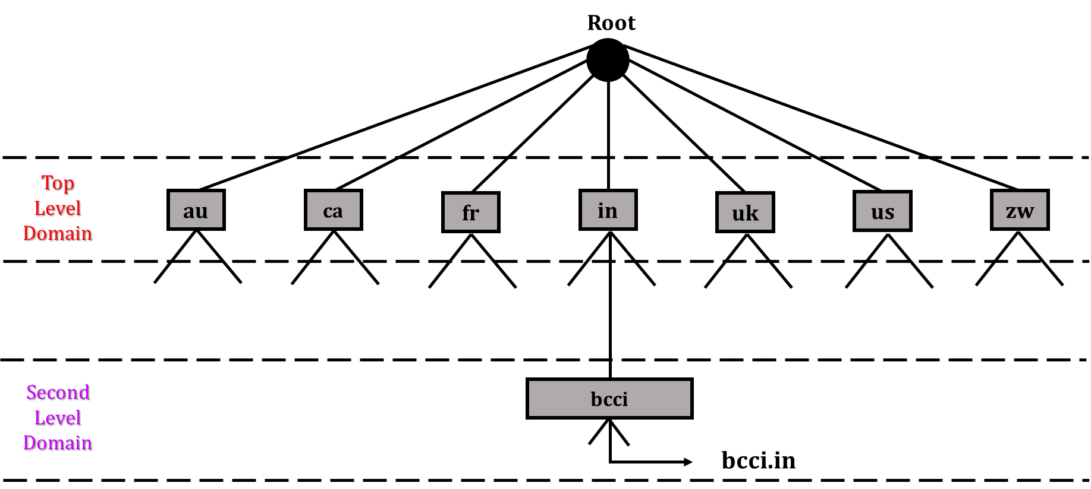
DNS
Country Domain
For example, bcci.in

Slide 51
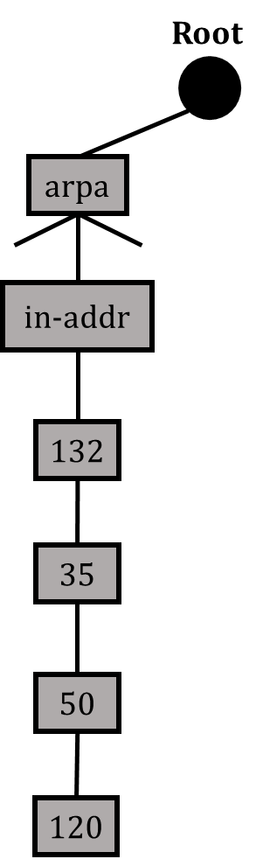
DNS
Inverse Domain
Inverse domain is used to map an address to a name.
For example, a client send a request to the server for performing a particular task, server finds a list of authorized client.
The list contains only IP addresses of the client.
The server sends a query to the DNS server to map an address to a name to determine if the client is on the authorized list.
This query is called an inverse query.
This query is handled by first level node called arpa.
132.35.50.120
⇒ 120.50.35.132 - in-addr - arpa

Slide 52
DNS
Name Space
The names assigned to the machines must be carefully selected from a name space with complete control over the binding between the names and IP addresses.
Name spaces are two types:
Flat name spaces
Hierarchical name spaces

Slide 53
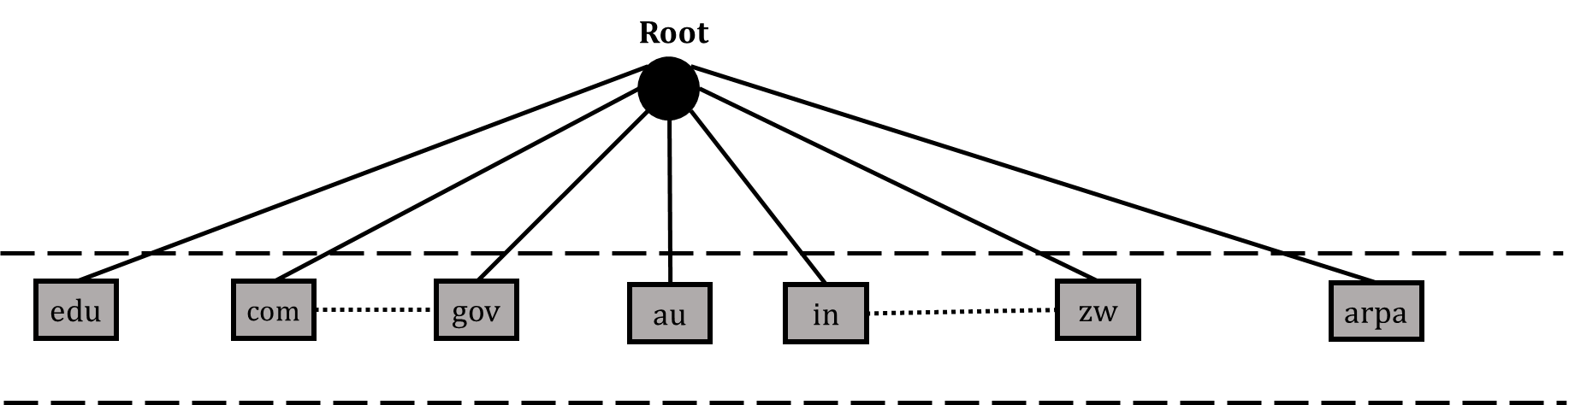
DNS
Flat name spaces
All the domain name connected with only root server, it creates flat name spaces.
There is no structure in flat name space.
Flat name spaces is not supported in large number of PCs in internet.
In flat name space central authority is overloaded

Slide 54
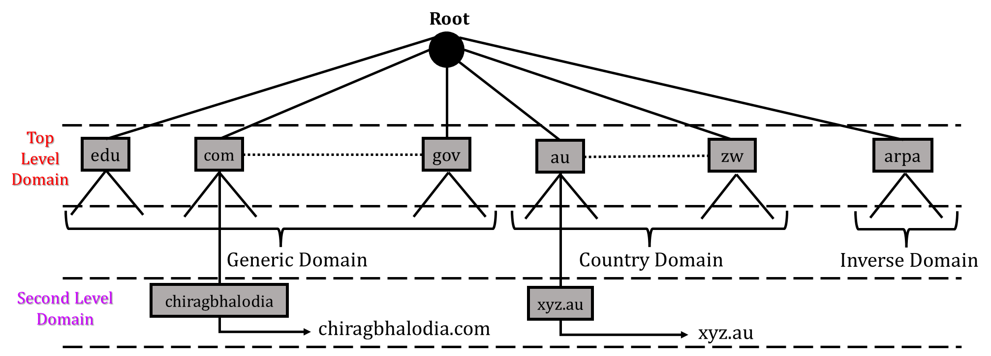
DNS
Hierarchical name spaces
Hierarchical namespaces provides a flexible naming structure.
The namespace is partitioned at the top level.
The top level domains are divided into three areas: Generic, Country, Inverse.
abc
Abc.com

Slide 55
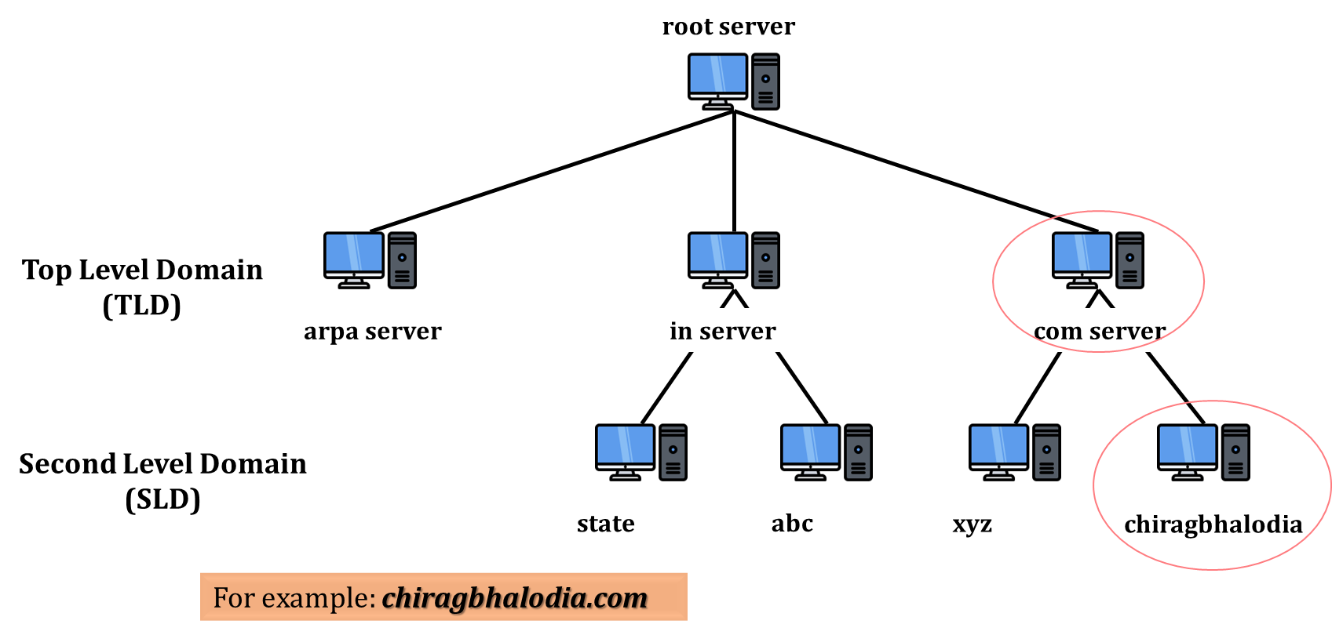
DNS
Name Server
A DNS name server is a server that stores the DNS records. It is also known as phone book of internet.
The purpose of name server: It help to connect URLs with the IP address of web servers.
To distribute the information among many computers, DNS servers are used.
Creates many domains as there are first level nodes.
Figure shows hierarchy of name servers.
pqr
pqr
For Example: pqr.com

Slide 56
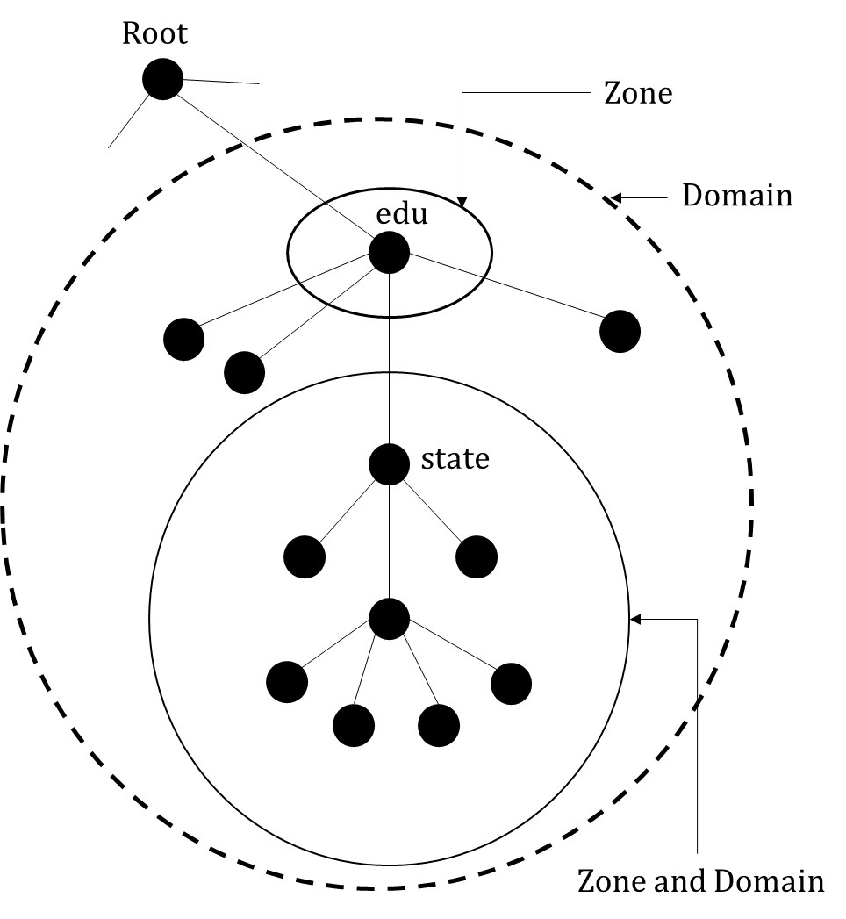
DNS
Name Server
Zone:
Server have some authority and also responsible for operation.
Server creates database, which is called zone file.
Server maintains all the information about node of that domain.
Figure shows domain with zone.
Domain and zone are same if server accepts responsibility for a domain and does not divide the domain into sub domain.
Domain and zone are different, if a server divides its domain into sub domain and delegates part of its authority to other server.

Slide 57
DNS
Name Server
Root Server:
If zone consists of the full tree then that zone server is called root server.
Root server do not maintain any information about domains.
DNS uses two types of servers: Primary and Secondary
Primary Server: This server keeps a file about the zone for which it is responsible and have authority. It performs operation on zone file like create, update and maintaining.
Secondary Server: It loads all information from the primary server. Secondary server cannot perform any operation on zone file.

Slide 58
DNS
Name Resolver
DNS is designed as a client server application.
A host that needs to map an address to a name or a name to an address called a DNS client named a resolver.
There are two types of Name resolver:
Mapping a Domain name to address
Mapping an address to a domain name

Slide 59
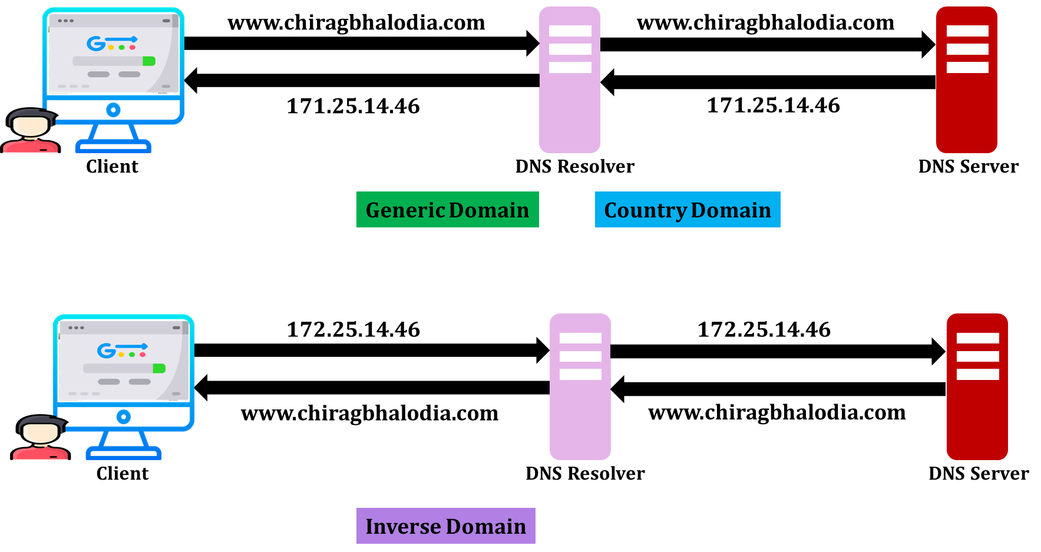
DNS
Mapping a Domain name to address
Mapping an address to a domain name
www.abc.com
www.abc.com
www.abc.com
www.abc.com

Slide 60
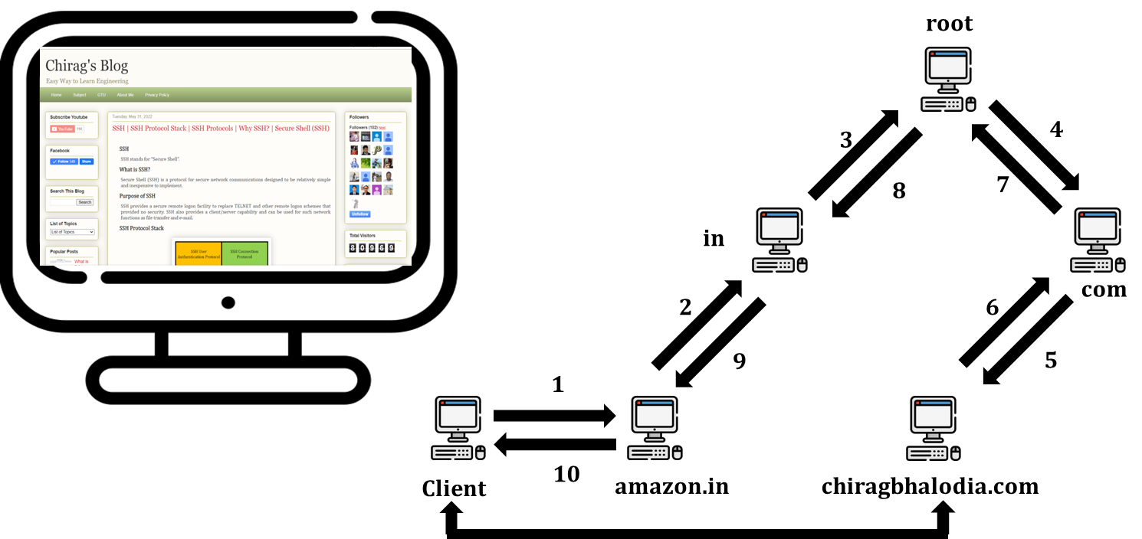
Name Resolver
Recursive Method
Abc.com

Slide 61
DNS
Recursive Method
The client (resolver) can ask for a recursive answer from a name server. This means that the resolver expects the server to supply the final answer.
If the server is the authority for the domain name, it checks its database and responds. If the server is not the authority, it sends the request to another server (the parent usually) and waits for the response.
If the parent is the authority, it responds; otherwise, it sends the query to yet another server.
When the query is finally resolved, the response travels back until it finally reaches the requesting client.
This is called recursive resolution and is shown in Figure.

Slide 62
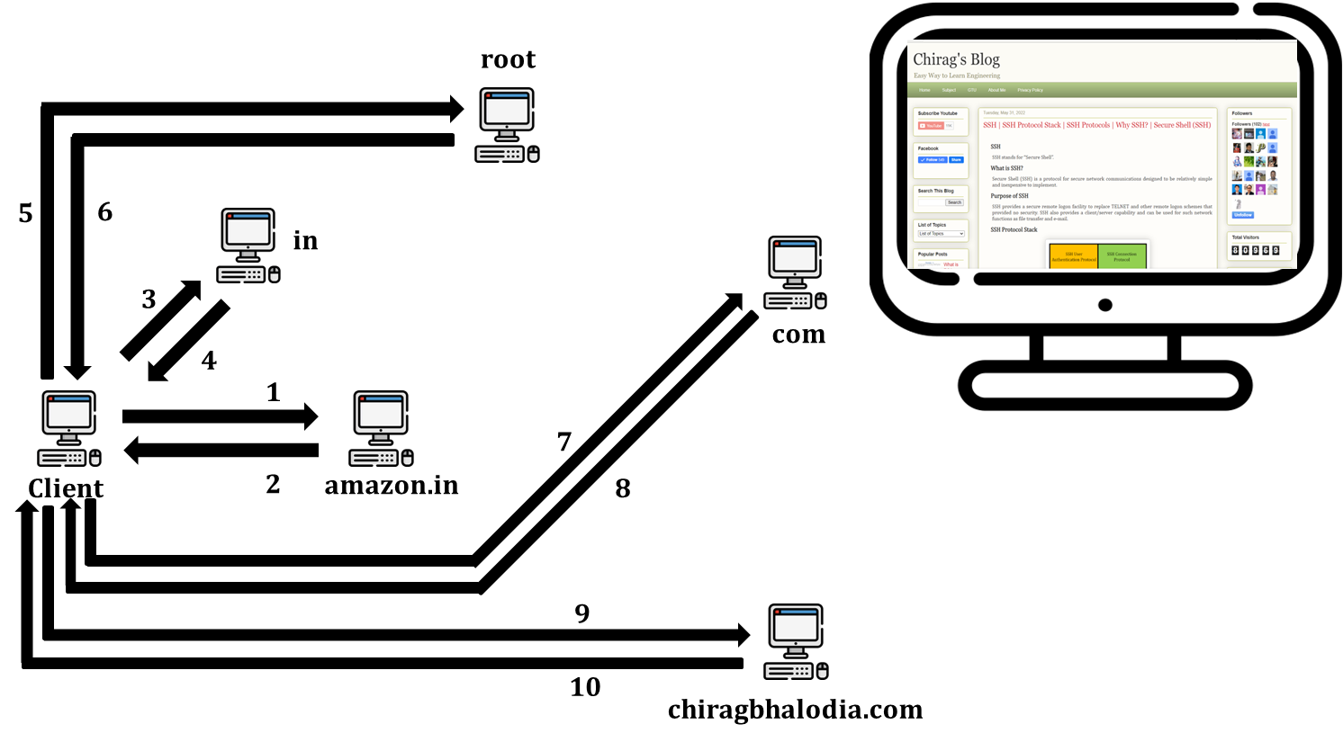
Name Resolver
Iterative Method
Abc.com

Slide 63
DNS
Recursive Method
If the client does not ask for a recursive answer, the mapping can be done iteratively.
If the server is an authority for the name, it sends the answer. If it is not, it returns (to the client) the IP address of the server that it thinks can resolve the query. The client is responsible for repeating the query to this second server.
If the newly addressed server can resolve the problem, it answers the query with the IP address; otherwise, it returns the IP address of a new server to the client.
Now the client must repeat the query to the third server. This process is called iterative resolution because the client repeats the same query to multiple servers.
In Figure shows the client queries for servers before it gets an answer from the chiragbhalodia.com server.

Slide 64
SNMP

Slide 65
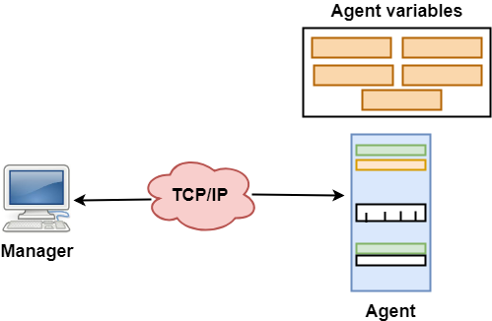
SNMP
SNMP stands for Simple Network Management Protocol.
SNMP is a framework used for managing devices on the internet.
It provides a set of operations for monitoring and managing the internet.
SNMP has two components Manager and agent.
The manager is a host that controls and monitors a set of agents such as routers.
It is an application layer protocol in which a few manager stations can handle a set of agents.

Slide 66
SNMP
Manager & Agent
A manager is a host that runs the SNMP client program while the agent is a router that runs the SNMP server program.
The agent is used to keep the information in a database while the manager is used to access the values in the database.
For example, a router can store the appropriate variables such as a number of packets received and forwarded while the manager can compare these variables to determine whether the router is congested or not.
Agents can also contribute to the management process.
A server program on the agent checks the environment, if something goes wrong, the agent sends a warning message to the manager.

Slide 67
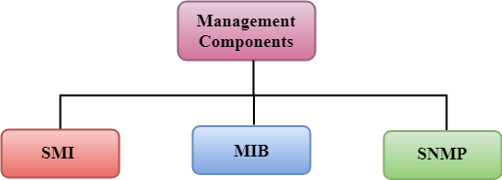
SNMP
Management Components
Management is not achieved only through the SNMP protocol but also the use of other protocols that can cooperate with the SNMP protocol.
Management is achieved through the use of the other two protocols: SMI (Structure of management information) and MIB(management information base).
Management is a combination of SMI, MIB, and SNMP.
SMI – Structure of Management Information
MIB – Management Information Base

Slide 68
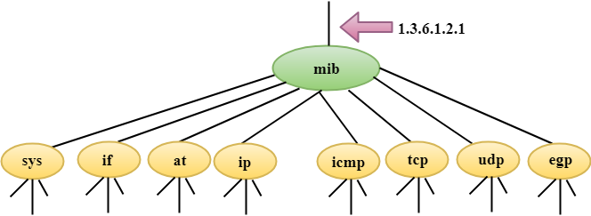
SNMP
SMI (Structure of Management Information)
The SMI (Structure of management information) is a component used in network management.
The main function of SMI is to define the type of data that can be stored in an object and to show how to encode the data for the transmission over a network.
MIB (Management Information Base)
Each agent has its own MIB, which is a collection of all the objects that the manager can manage.
MIB is categorized into eight groups: system, interface, address translation, ip, icmp, tcp, udp, and egp. These groups are under the mib object.

Slide 69
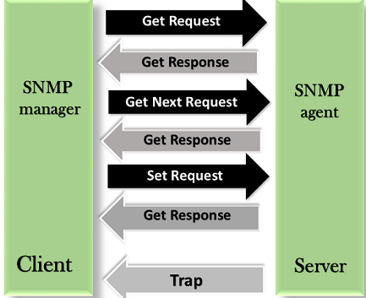
SNMP
SNMP
SNMP defines five types of messages: GetRequest, GetNextRequest, SetRequest, GetResponse, and Trap.
GetRequest: The GetRequest message is sent from a manager (client) to the agent (server) to retrieve the value of a variable.
GetNextRequest: The GetNextRequest message is sent from the manager to agent to retrieve the value of a variable. This type of message is used to retrieve the values of the entries in a table. If the manager does not know the indexes of the entries, then it will not be able to retrieve the values. In such situations, GetNextRequest message is used to define an object.

Slide 70
SNMP
SNMP
GetResponse: The GetResponse message is sent from an agent to the manager in response to the GetRequest and GetNextRequest message. This message contains the value of a variable requested by the manager.
SetRequest: The SetRequest message is sent from a manager to the agent to set a value in a variable.
Trap: The Trap message is sent from an agent to the manager to report an event. For example, if the agent is rebooted, then it informs the manager as well as sends the time of rebooting.

Slide 71
DHCP

Slide 72
DHCP
DHCP stands for Dynamic Host Configuration Protocol.
DHCP is an application layer protocol.
DHCP is a client/server protocol that automatically provides an IP address to host and other related configuration information such as the subnet mask and default gateway.
In DHCP, port number 67 is used for the server and 68 is used for the client.
DHCP allows a network administrator to supervise and distribute IP addresses from a central point and automatically sends a new Internet Protocol (IP) address when a computer is plugged into a different place in the network.
In DHCP, there are 4 messages: Discovery, Offer, Request and Acknowledge. It is also known as “DORA” process.

Slide 73
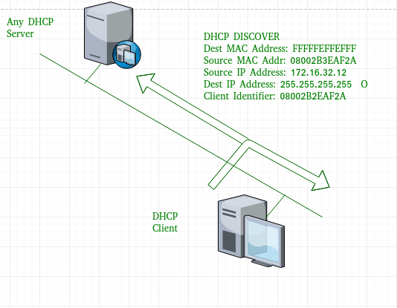
DHCP
DHCP discover message
This is a first message generated in the communication process between server and client.
This message is generated by Client host in order to discover if there is any DHCP server/servers are present in a network or not.
This message is broadcasted to all devices present in a network to find the DHCP server.

Slide 74
DHCP
DHCP discover message
As shown in the figure, source MAC address (client PC) is 08002B2EAF2A, destination MAC address(server) is FFFFFFFFFFFF, source IP address is 0.0.0.0(because PC has no IP address till now) and destination IP address is 255.255.255.255 (IP address used for broadcasting).
As the discover message is broadcast to find out the DHCP server or servers in the network therefore broadcast IP address and MAC address is used.

Slide 75
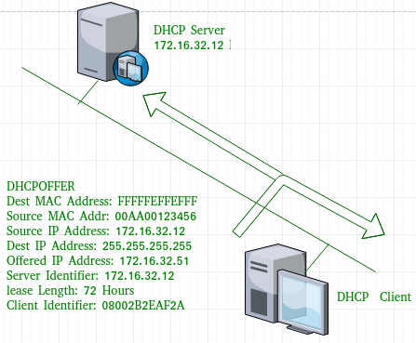
DHCP
DHCP offer message
The server will respond to host in this message specifying the unleased IP address and configuration information.
This message is broadcasted by server.
If there are more than one DHCP servers present in the network then client host will accept the first DHCP OFFER message it receives.
Also a server ID is specified in the packet in order to identify the server.

Slide 76
DHCP
DHCP offer message
Now, for the offer message, source IP address is 172.16.32.12 (server’s IP address in the example), destination IP address is 255.255.255.255 (broadcast IP address), source MAC address is 00AA00123456, destination MAC address is FFFFFFFFFFFF.
Here, the offer message is broadcast by the DHCP server therefore destination IP address is broadcast IP address and destination MAC address is FFFFFFFFFFFF and the source IP address is server IP address and MAC address is server MAC address.

Slide 77
DHCP
DHCP offer message
Also the server has provided the offered IP address 192.16.32.51 and lease time of 72 hours(after this time the entry of host will be erased from the server automatically).
Also the client identifier is PC MAC address (08002B2EAF2A) for all the messages.

Slide 78
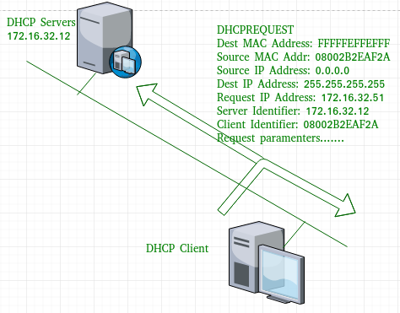
DHCP
DHCP request message
When a client receives a offer message, it responds by broadcasting a DHCP request message.
The client will produce a complimentary ARP in order to find if there is any other host present in the network with same IP address.
If there is no reply by other host, then there is no host with same IP configuration in the network and the message is broadcasted to server showing the acceptance of IP address.
A Client ID is also added in this message.

Slide 79
DHCP
DHCP request message
Now, the request message is broadcast by the client PC therefore source IP address is 0.0.0.0(as the client has no IP right now) and destination IP address is 255.255.255.255 (broadcast IP address) and source MAC address is 08002B2EAF2A (PC MAC address) and destination MAC address is FFFFFFFFFFFF.
Note – This message is broadcast after the ARP request broadcast by the PC to find out whether any other host is not using that offered IP. If there is no reply, then the client host broadcast the DHCP request message for the server showing the acceptance of IP address and Other TCP/IP Configuration.

Slide 80
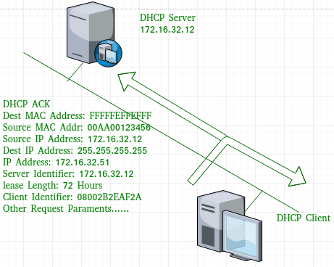
DHCP
DHCP acknowledgement message
In response to the request message received, the server will make an entry with specified client ID and bind the IP address offered with lease time. Now, the client will have the IP address provided by server.
Now the server will make an entry of the client host with the offered IP address and lease time.
This IP address will not be provided by server to any other host. The destination MAC address is FFFFFFFFFFFF and the destination IP address is 255.255.255.255 and the source IP address is 172.16.32.12 and the source MAC address is 00AA00123456 (server MAC address).

Slide 81
DHCP
DHCP acknowledgement message
DHCP negative acknowledgement message – Whenever a DHCP server receives a request for IP address that is invalid according to the scopes that is configured with, it send DHCP Nak message to client. Eg-when the server has no IP address unused or the pool is empty, then this message is sent by the server to client. (Server to client)
DHCP decline – If DHCP client determines the offered configuration parameters are different or invalid, it sends DHCP decline message to the server .When there is a reply to the complimentary ARP by any host to the client, the client sends DHCP decline message to the server showing the offered IP address is already in use. (Client to server)
DHCP release – A DHCP client sends DHCP release packet to server to release IP address and cancel any remaining lease time. (Client to server)
DHCP inform – If a client address has obtained IP address manually then the client uses a DHCP inform to obtain other local configuration parameters. In reply to the dhcp inform message, DHCP server generates DHCP ack message with local configuration suitable for the client without allocating a new IP address.

Slide 82

Thank
You

Slide 83
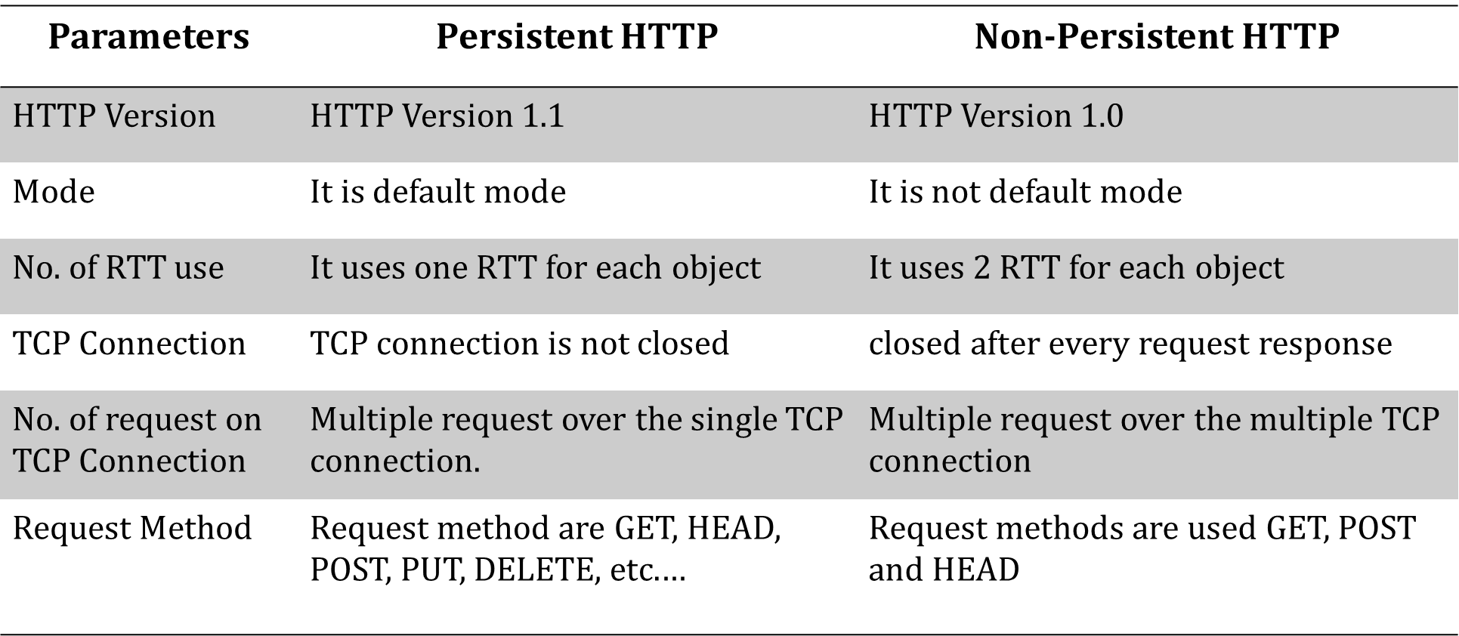
Persistent HTTP vs Non-persistent HTTP

